Slide 1

Rural Food Processing
17 April 2020
ME 486C - Team Cocoyam
Samantha Morrison - Project Manager
Nygel des Vignes - Financial Manager
Musab Al-Balool - Manufacturing Engineer
Humoud Alanjari - Logistics Manager
Sponsored By:

Slide 2
Outline of Presentation
17 April 2020
Project Description
Project Deliverables
Requirements
Design Description and CAD
Manufacturing - Final product
Testing
Budget
Bill of Materials
Future Work and Recommendations
Rural Food Processing
Al-Balool 2

Slide 3
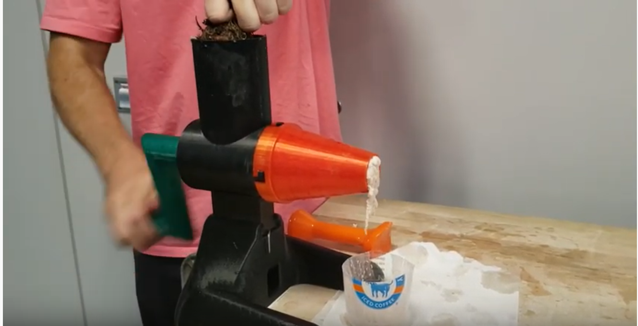
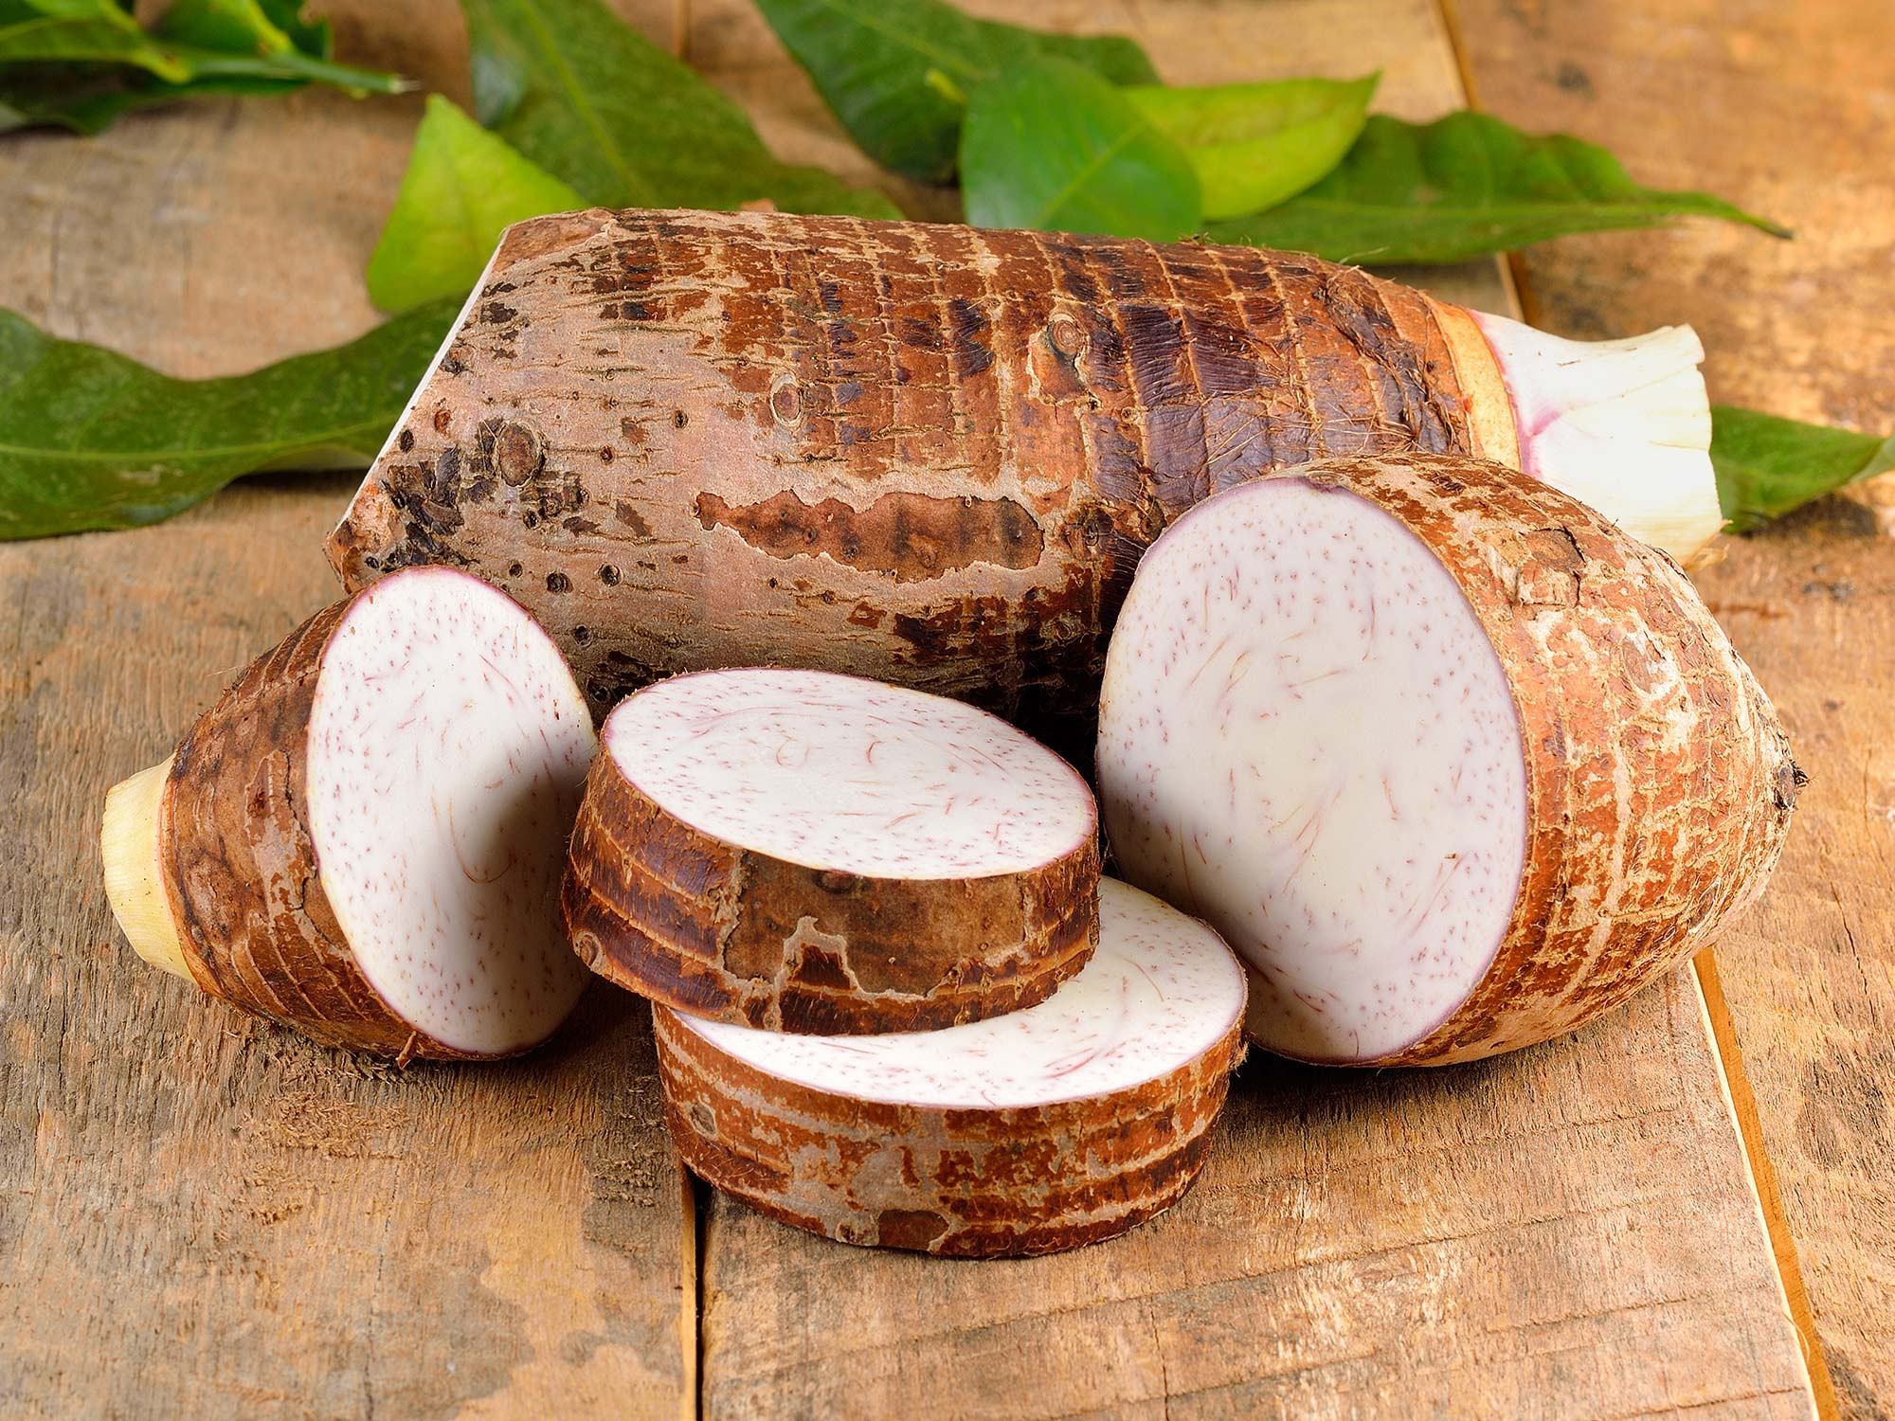
Project Description
17 April 2020
Improve upon current hand rolling technique
Help West and Central African Communities
Cocoyam dispenser and roller
Continuation of Georgia Tech’s grinder
Create a design package that can be transferred and replicated easily
Client- Isaac Zama - Humanitarian
Mentor - Chuck Vallance
Sponsor - W.L. Gore
Figure 1: Manual grinder by Georgia Tech [1]
Figure 2: Raw Cocoyam [2]
Rural Food Processing
Al-Balool 3

Slide 4
Project Deliverables
17 April 2020
Simple design that is easily manufacturable
  Wooden roller final product
  Uses material readily available
Efficient
  Needs to provide improvement in order to be adopted by locals
Intuitive
  Has to be simple enough for all ages to use
Clear Instructions
  Operations and Assembly Manual will assist by providing easy-to-follow instructions and operation recommendations for best results
  Prepared video of the team’s manufacturing of the design will also aid
Rural Food Processing
Al-Balool 4

Slide 5
Requirements
17 April 2020
Engineering Requirements
  Low cost < $45
  Minimize the time to produce one roll < 20 seconds
  Light weight [kg] < 10kg
  Base footprint area [m²] < 0.625m²
  Smooth edges [mm] radius < 5mm
  Low center of gravity
  Factor of safety >3
Customer Requirements
  Reliable
  Durable
  Lightweight
  Safe to use
  Simple
  Low cost
  Easy to use by anyone
  Mobile
  Faster than hand rolling
Rural Food Processing
Al-Balool 5

Slide 6
Requirements
17 April 2020
Verify Requirements
Drop test
Software analysis - weight, durability, FEA, bolts factor of safety.
Roller production time with plexiglass prototype
Dimension test
Some Values Achieved by Design
Mass of the system - 7.22kg
Base footprint area - 0.12m²
Radius of edges - 1mm
Center of gravity as expected
Force to push handle - 2.44lbs
Final product cost $42.94
Rural Food Processing
Al-Balool 6

Slide 7
Prototype 1 - Plexiglass and 3D Printed
17 April 2020
First high-fidelity prototype
Base of dispenser and roller made from plexiglass
Bolts secure brackets to base of roller
Dispenser design flawed
  Would not flow through outlet as easily as expected
  Prompted decision to redesign
Figure 3: Plexiglass and 3D Filament Prototype
Rural Food Processing
Morrison 7

Slide 8
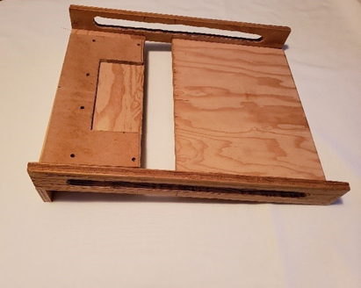
Prototype 2 - Wood & 3D Printed
17 April 2020
Re-manufacturing prototype design to work with client’s desired material
  Only base and brackets
  Handle remains 3D printed
Side rails and fasteners were main change
Main concerns moving to final design:
  Slotted holes in brackets
    Needed to be smoother
  Use of silicone sheet with new base material
Figure 4: First Wood Prototype
Rural Food Processing
Morrison 8

Slide 9
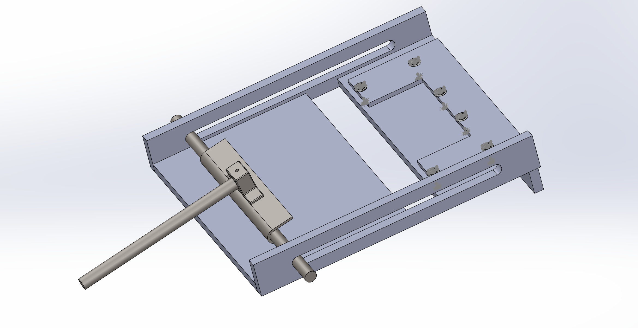
Design Description - Roller CAD
17 April 2020
(3)
How Subsystem Functions:
  Cocoyam and leaf placed (1)
  User holds handle (2)
  User pushes handle to end of rail (3)
  Cocoyam is rolled and deposited into crevice in base plate (4)
  User pulls handle to start of rail (5)
  User removes rolled Ekwang
(4)
(5)
(1)
(2)
Figure 5: Isometric view with numbered indicators
Rural Food Processing
Morrison 9

Slide 10
Full System CAD
17 April 2020
How System Functions:
  User uses dispenser subsystem to dispense desired amount onto prepared cocoyam leaf
  User uses roller subsystem to roll prepared leaf into dish
  Repeat until desired amount of rolls have been accomplished
Figure 6: Entire system (roller and mock-up of COTS dispenser)
Rural Food Processing
Morrison 10

Slide 11
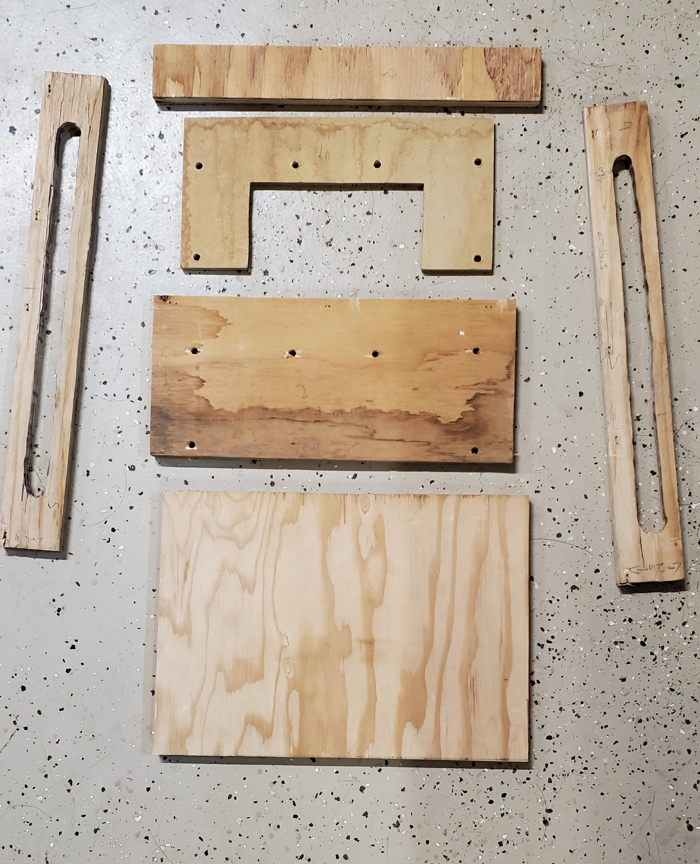
Manufacturing Final Product
17 April 2020
The final product was constructed from plywood and 3D printed parts
The handle was 3D printed to ease the manufacturing process
After all the pieces are cut out they are then fastened together with staples
Using a jigsaw the slots in the rails can be perfectly cut out for smooth rolling
Figure 7: Pieces of wood prototype
Rural Food Processing
Des Vignes 11

Slide 12
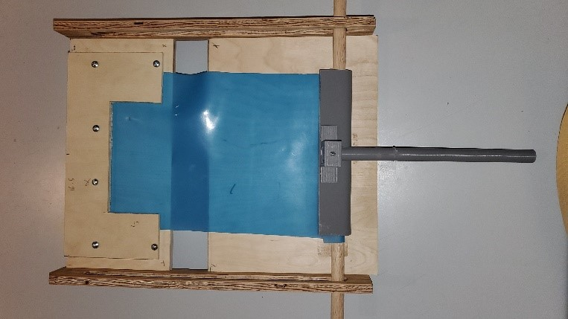
Manufacturing Final Product
17 April 2020
Once assembled a washable silicon sheet is clamped into place
The silicon sheet function as a belt to roll the cocoyam leaves
To seal the wood parts palm oil is used to coat the entire system
Palm oil helps protect the wood and helps the silicon sheet to grip the base for better rolling
Figure 8: Final Wood Design
Rural Food Processing
Des Vignes 12

Slide 13
Manufacturing - COTS
17 April 2020
With the viscosity of cocoyam paste being so high it does not flow easily
To allow for easy dispensing a caulking gun was purchased to give the user more control and mechanical advantage
Reusable tubes along with a cheap caulking were purchased along with a more expensive one piece caulking gun
Both work flawlessly but one is more affordable
Figure 9: Final Dispenser
Rural Food Processing
Des Vignes 13

Slide 14
Budget/Purchasing
17 April 2020
Table 1: Budget Breakdown
Low Fidelity Prototype | $41.63
Plexiglass Prototype | $ 85.73
Wood Prototypes | $ 52.37
New Dispenser | $ 39.20
Miscellaneous | $95.06
Testing | $145.54
Total | $459.53
Budget Remaining | $1,040.47
Total budget of $1500 from Gore
Currently have $1040.47 remaining
Prototyping has been main expense at $313.99
The plexiglass prototype was the most expensive prototype to build since the team had to order a larger amount of plexiglass for a previous dispenser idea along with the base’s materials
Viscosity testing cost $145.54 but allowed the team to gain valuable knowledge
Rural Food Processing
Des Vignes 14

Slide 15
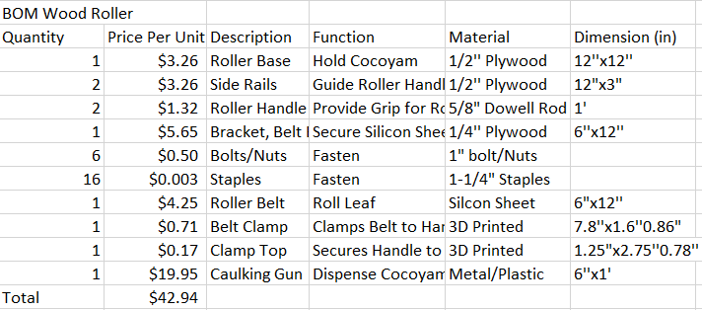
Bill Of Materials
17 April 2020
Table 2: Bill of Materials
The final prototype fell beneath the $45 dollar maximum set by the client
With the more expensive caulking gun being used the device would $42.94 to produce
With the least expensive caulking gun and reusable tubes it would cost $33.74 to produce
Rural Food Processing
Alanjari 15

Slide 16
Tests Completed
17 April 2020
Drop test
Dropped the wood prototype from 4ft ledge causing it to fail when the staples pulled out of the rail
Software Analysis
-Analyzed the weight, durability, strength, Bolts factor of safety using, SolidWorks properties tab and FEA simulation
Roll production time (only with plexiglass prototype)
The team was able to produce cocoyam rolls with the plexiglass model. The device passed this test and was well below the one roll per 20 second time limit
Dimension Test
Base footprint area [m²] < 0.625m²
Rural Food Processing
Alanjari 16

Slide 17
Tests Uncompleted
17 April 2020
Due to the unforeseen circumstances of the semester, some tests were unable to be completed because of a lack of access to supplies and inability to meet
Some tests anticipated to be completed includes:
  Roll production time (Wood Prototype)
    Ensure roll time achieved with plexiglass prototype is consistent
  Smooth edge test
    Check for sharp edges
  Stability test
    Test impact of measured forces on design
Rural Food Processing
Alanjari 17

Slide 18
Future Work
17 April 2020
Deliver to client
  Operation/ Assembly Manual
  CAD Package
  Send Final Product to client
Final Report
Rural Food Processing
Rural Food Processing
Alanjari 18

Slide 19
Thank You
Any Questions?
17 April 2020
Rural Food Processing
19

Slide 20
Citations
17 April 2020
[1] Evan Williamson, “Coco-YUM! - The manual cocoyam processor,” YouTube, 23-Jul-2019. [Online]. Available: https://www.youtube.com/watch?v=siXvcSSyxC4#action=share. [Accessed: 15-Sep-2019].
[2] Admin, “Health Benefits and Nutrition of Taro Root,” TAROTO TAIWANESE HEALTHY DESSERT. [Online]. Available: https://tarotodessert.com/en/2017/health-benefits-and-nutrition-of-taro-root/. [Accessed: 17-Sep-2019].
Rural Food Processing
20

